Slide 1
Introduction to Hardware AND IoT
CyberLabs

Slide 2
What do we do?
Build interactive systems using both hardware and software that can sense and respond to the physical world.

Slide 3
Microcontrollers
Microprocessor
A microcontroller is an application specific computer that usually runs a single program performing dedicated tasks
A microcontroller contains on chip CPU, input/output interface, memory, clock, timer, and an assortment of of other peripherals.
Microprocessor is a controlling unit of a micro-computer, fabricated on a small chip capable of performing operations and communicating with the other devices connected to it.
one has to add externally memory, clock, input/output interfaces, timer and all other needed peripherals.

Slide 4
Arduino Board
Arduino board is a development board.
There are different types of Arduino boards which use different microcontrollers and have different RAM and Flash memories.
Eg; Arduino Uno/Mega/Nano.

Slide 5
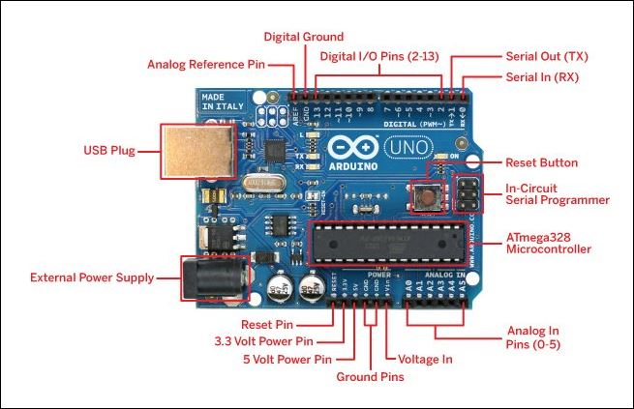

Slide 6
I/O in Hardware
Sensors
Actuators
Sense the changes in any physical parameter and sends this data to the microcontroller as input signal in form of voltage change.
Microcontroller performs certain operations based on the inputs received by the sensors and provides a desired output with the help of actuators like leds, motors, speakers, buzzers.

Slide 7
Pulse Width Modulation
Method of getting analog type of signals using digital means.
We can simulate output voltages obtained at digital pins between 0(LOW) and 5V (HIGH) by changing the portion of time signal spends ON versus the time signal is OFF.
If the ON-OFF cycle is repeated fast enough it appears as if the output is maintained at a steady voltage between 0V to 5V.

Slide 8
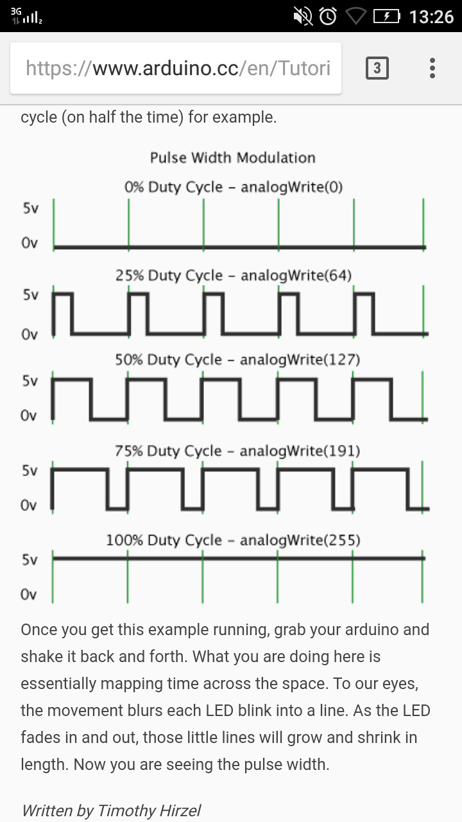

Slide 9
Serial & Parallel Communication
Serial Communication - Data is sent one bit at a time.
Parallel Communication - Multiple binary digits are conveyed simultaneously .
The transfer of data from the computer to Microcontroller happens serially.
Serial Monitor is used to view the incoming and outgoing data at the Serial port.

Slide 10
Arduino IDE
Its an open source Arduino Software to write codes and upload them to the board and program the microcontroller.
It can be used with any Arduino board and also few other microcontroller development boards by adding certain extensions to the software.

Slide 11
Arduino Programming
The main elements of Arduino code:
Variables
Functions
Libraries

Slide 12
Structure of a Sketch
void setup()
{
}
void loop()
{
}

Slide 13
Libraries
Libraries are a collection of code that makes it easy for you to connect to a sensor, display, module, etc.

Slide 14
Functions
int myMultiplyFunction(int x, inty)
{
int result;
result = x * y;
return result;
}

Slide 15
Arduino Programming
Digital I/O (for digital
pins)
Analog I/O (for analog
pins)
digitalRead()
digitalWrite()
pinMode()
analogRead()
analogWrite()

Slide 16
Led Blink
int val;
void setup()
{
Serial.begin(9600);
pinMode(13, OUTPUT);
// sets the digital pin 13 as output}

Slide 17
void loop()
{
digitalWrite(13, HIGH);
// sets the digital pin 13 on
delay(1000); // waits for a second
digitalWrite(13, LOW);
delay(1000);
// sets the digital pin 13 off
}

Slide 18
Led brightness control with ldr sensor
#define LDRpin A0
int led=13;
int ldrvalue=0;
int brightness;
void setup()
{
pinMode(led,OUTPUT);
pinMode(LDRpin,INPUT); Serial.begin(9600); }

Slide 19
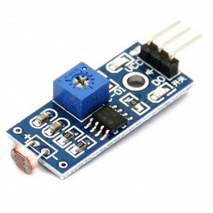
void loop()
{ ldrvalue= analogRead(LDRpin); Serial.println(ldrvalue);
brightness=map(ldrvalue,0,1023,0,255) ;
analogWrite(ledpin , brightness);
}

Slide 20
Internet of Things
Internet of Things (IoT) is an ecosystem of connected physical objects that are accessible through the internet.

Slide 21
Things?
The ‘thing’ in IoT could be a person with a heart monitor or an automobile with built-in-sensors.
These are objects that have been assigned an IP address and have the ability to collect and transfer data over a network without manual intervention.

Slide 22
How IoT Works?
Internet of Things is not the result of a single novel technology; instead, several complementary technical developments provide capabilities that taken together help to bridge the gap between the virtual and physical world.

Slide 23
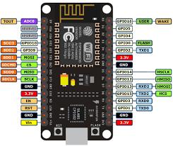
NodeMCU

Slide 24
Development Boards
Raspberry Pi
Particle Photon
ESP32-CAM
Brainium SMARTEDGE AGILE (Humidity / Temperature/ Proximity sensor, etc.)

Slide 25
References
https://www.arduino.cc/reference/en/
https://www.circuito.io/
https://io.adafruit.com/
https://ubidots.com/
https://www.hackster.io/
https://www.instructables.com/circuits/arduino/projects/

Slide 26
Thank You

